Slide 1


Understanding Reservoir Connectivity and Tar Mat Using Gravity-Induced Asphaltene Compositional Grading
Sai R. Panuganti – Rice University, Houston
Advisor: Prof. Walter G. Chapman – Rice University, Houston
Co-advisor: Prof. Francisco M. Vargas – The Petroleum Institute, Abu Dhabi

Slide 2
Outline
Introduction
Motivation
PC-SAFT asphaltene phase behavior modeling
Predicting asphaltene compositional gradient
Prediction of tar-mat occurrence depth
Conclusion
Future release

Slide 3
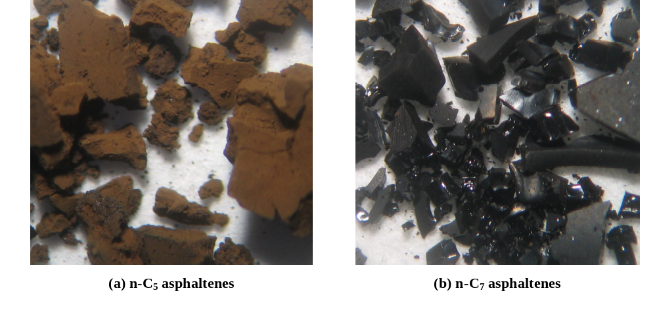
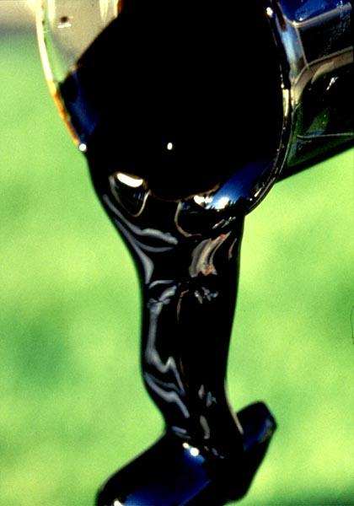
Fast Facts about Asphaltene
Polydisperse mixture of the heaviest and most polarizable fraction of the oil
Defined in terms of its solubility
  Miscible in aromatic solvents, but insoluble in light paraffin solvents
Molecular structure is not completely understood
Behavior depends strongly on P, T and {x_{i}}
(a) n-C₅ asphaltenes
(b) n-C₇ asphaltenes
Jill Buckley, NMT
http://www.gasandoilresearch.com/asph.html

Slide 4
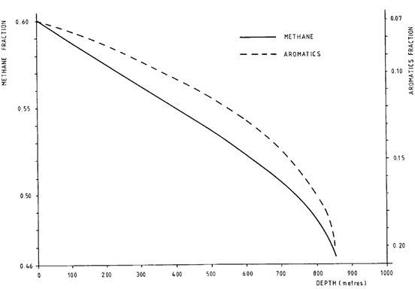
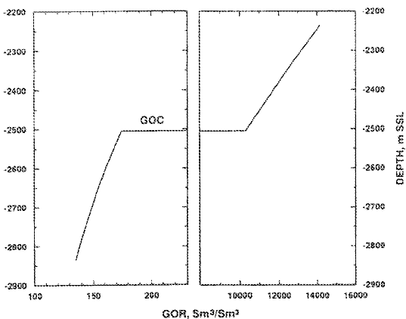
Compositional Grading Introduction
Used for:
First theoretical explanation – Morris Muskat, 1930
Used for:
1. To predict oil properties with depth
2. Find out gas-oil contact
Muskat M., Physical Review, 1930; 35:1384:1393
Schulte, A.M., SPE Conference, 1980; September 21-25, SPE 9235

Slide 5
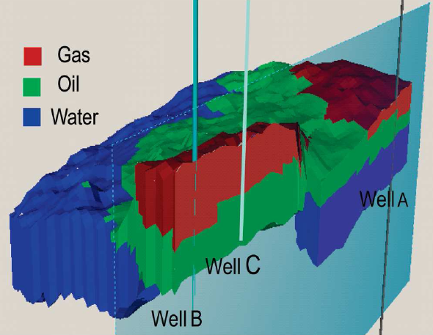
Motivation
Reservoir Connectivity
Tar Mat
“ The presence of a tar mat could not be inferred from the PVT behavior of the reservoir oil in the upper part of the reservoir “ – Hirschberg, A. JPT 1988; 40(1):89-94
Understanding reservoir connectivity helps in effective sweep of oil for a given number of wells
Pressure communication can be used only to understand compartmentalization
Zao, J.Y., et al., Journal of Chemical & Engineering Data, 2011; 56(4):1047-1058

Slide 6
PC-SAFT Modeling of Asphaltene PVT Behavior
Tahiti Field -
Black Oil,
Offshore,
Gulf of Mexico
Precipitant – C1
Precipitant – C2
Precipitant – C3
S Field –
Light Oil,
Onshore,
Middle East
Asphaltene Onset Pressure
Bubble Pressure
Panuganti, S.R. et al., Fuel, 2012; 93:658-669

Slide 7
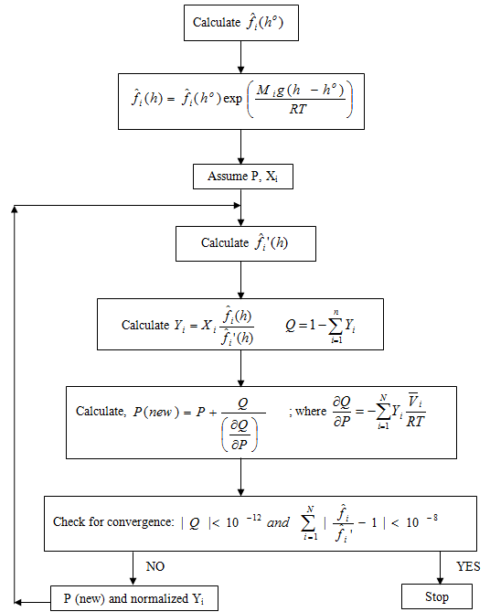
Isothermal Compositional Grading Algorithm
Whitson, C.H., Belery, P., SPE 28000; 1994, 443-459

Slide 8
Verifying the Compositional Grading Algorithm
Tahiti Field

Slide 9
Verifying the Compositional Grading Algorithm
Tahiti Field
PC-SAFT prediction matches the field data, verifying the successful working of the compositional grading algorithm

Slide 10
Asphaltene Grading
Tahiti field, Offshore in Gulf of Mexico
Black oil, isothermal reservoir at equilibrium
Optical density measured using infra red wavelength during down-hole fluid analysis
Freed, D.E. et al., Energy and Fuels, 2011; 24:3942-3949

Slide 11
Predicting Asphaltene Compositional Grading
All continuous lines are PC-SAFT predictions
All zones belong to the same reservoir as the gradient slopes are nearly the same
The curves do not overlap implying each zone belongs to different compartment

Slide 12
PC-SAFT Asphaltene Compositional Grading
Tahiti
field
PC-SAFT asphaltene compositional grading extended to further depths
Field observations did not report any tar mat

Slide 13
Predicting Asphaltene Compositional Grading
S field
All continuous lines are PC-SAFT predictions
All zones belong to the same reservoir as the gradient slopes are nearly the same
The curves do not overlap implying each zone belongs to different compartment
Wells X and Y are connected because they lie on the same asphaltene grading curve

Slide 14
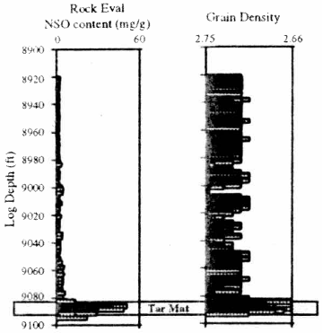
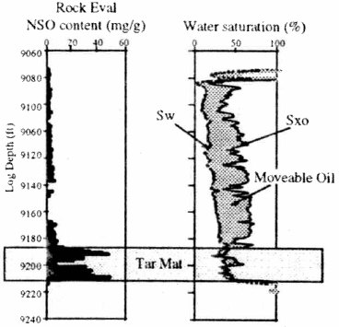
Tar-mat
              Onshore
                S field
Tar-mat formation mechanism of S field
Asphaltene compositional grading
Other tar-mat formation mechanisms
Settling of precipitated asphaltene
Asphaltene can adsorption onto mineral surfaces
Oil-water contact
Biodegradation
Maturity between the oil leg and tar-mat
Oil cracking
Carpentier, B. et al. Abu Dhabi International Petroleum Exhibition and Conference 1998; November 11-14

Slide 15
Predicting Tar-mat Occurrence
Matches field observations and tar-mat’s asphaltene content in SARA
Zone 1 – Liquid 1 (Asphaltene lean phase)
Zone 2 – Liquid 1 + Liquid 2
Zone 3 – Liquid 2 (Asphaltene rich phase)
Such a prediction is possible only with an equation of state
Predicted tar-mat formation depth matching the field data, from PVT behavior in the upper parts of the reservoir
S field
Zone 1
Zone 2
Zone 3
Panuganti, S.R. et al., Energy and Fuels, 2011; dx.doi.org/10.1021/ef201280d

Slide 16
Tar-mat Analysis
Tahiti field
S field
Can the T field have an S field situation and vice versa ?

Slide 17
Asphaltene Compositional Gradient Isotherms
S
field
Liquid 1 + Liquid 2
Thus any field can show large or low asphaltene gradients without a need of asphaltene precipitation
Panuganti, S.R. et al., Energy and Fuels, 2012; The 1st International Conference on Upstream Engineering and Flow Assurance

Slide 18
Conclusion
Successful capture of asphaltene PVT behavior in the upper parts of the reservoir
Evaluated reservoir connectivity through asphaltene compositional grading
Predicted tar-mat occurrence depth because of asphaltene compositional grading

Slide 19
Future Release
 | Input Parameters
Property | Density | Mol. Weight | Boiling Point | Function of Temperature | Mixtures
Critical Temperature | Y | Y | Y | N/A | Y
Critical Pressure | Y | Y | Y | N/A | Y
Surface Tension | Y | Y | Y | Y | N
Molecular Polarizability | N | Y | N | N/A | N/A
Dielectric Constant | Y | N | N | Y | Y
Basis : Quantum and Statistical Mechanics

Slide 20
Predicted vs Experiment

Slide 21
Predicted vs Experiment

Slide 22







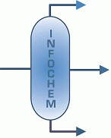

Acknowledgement
ADNOC OPCO’s R&D
DeepStar
Chevron ETC
Schlumberger
New Mexico Tech
Infochem
VLXE

